Slide 1
Building a Robust Medical Chatbot: Comparative Analysis of FAISS-GPT and RAG Approaches
By- Shikshit Gupta
Vaibhav Mishra

Slide 2




List of Content
Introduction
Approaches
Technologies Used
Comparison of Results
Challenges and learning
Demo
Future Work
Conclusion

Slide 3
Introduction
Medical chatbots provide instant access to healthcare information, assisting with symptom assessment, medication reminders, and general wellness advice, while promoting proactive healthcare practices and early intervention for health concerns.
This project aims to develop a robust medical chatbot using advanced NLP techniques to address existing limitations in healthcare accessibility and efficiency.
The primary objectives include building a scalable chatbot capable of accurately understanding and responding to queries while evaluating and comparing two approaches: FAISS-GPT and RAG-based pipelines.
By delivering a seamless user experience, the chatbot ensures high precision and contextual relevance in information retrieval and response generation.
The project is motivated by the need to bridge gaps in healthcare accessibility, particularly in remote or underserved regions, and to reduce the burden on traditional healthcare systems.
Leveraging state-of-the-art NLP technologies, this solution aims to create a reliable, adaptable, and scalable medical chatbot for enhanced healthcare support.

Slide 4
Approaches
FAISS-GPT Based Chatbot
Combines FAISS (Facebook AI Similarity Search) for retrieval and GPT (Generative Pre-trained Transformer) for response generation.
Process:
User input is embedded using JinaAI's model.
FAISS retrieves the most relevant sentences.
OpenAI GPT generates the final response using retrieved data.
RAG-Based Chatbot
Utilizes a Retrieval-Augmented Generation (RAG) pipeline for dynamic context retrieval and response generation.
Process:
Contexts stored in Pinecone with dense and sparse embeddings.
Questions embedded using a Sentence Transformer model.
Retrieved contexts feed into GPT for response generation, enhanced by LangChain for modularity.

Slide 5
Technologies Used
FAISS: High-performance similarity search for vectorized data.
1
Pinecone: Scalable vector database for context storage and retrieval.
2
JinaAI: Embedding model for sentence encoding in FAISS-GPT.
3
LangChain: Framework for building RAG pipelines.
4
OpenAI GPT: Used for response generation in both approaches.
5
SentenceTransformer: Model for dense vector embeddings in the RAG approach.
6
RAGAS: Evaluation framework for retrieval-augmented generation pipelines.
7

Slide 6
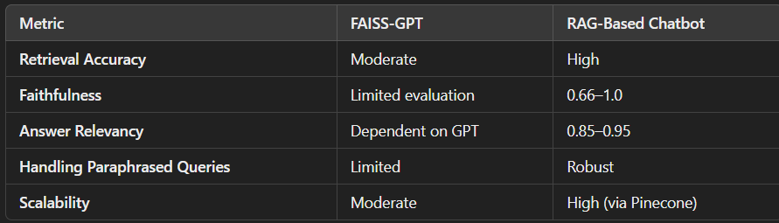
Comparison of Results
Performance Metrics

Slide 7
Challenges and Learning
Challenges:
Ensuring retrieval accuracy in FAISS for diverse queries.
Managing higher computational costs in the RAG pipeline.
Fine-tuning embeddings to balance dense and sparse vector accuracy.
Learnings:
Dynamic query handling is critical for a medical chatbot's robustness.
Combining retrieval and generation improves contextual understanding.
Evaluation metrics like faithfulness and relevancy are vital for assessing chatbot reliability.

Slide 8



Demo

Slide 9
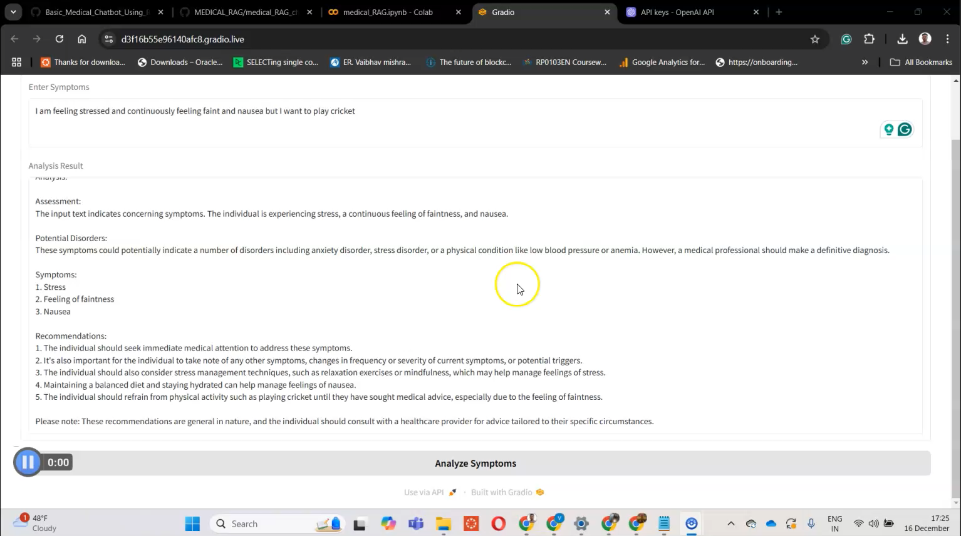

Slide 10
Future Work
Expand the medical database with more comprehensive and diverse datasets to improve the chatbot's versatility and accuracy.
Optimize response latency in the RAG pipeline to enable real-time applications for seamless user interactions.
Integrate multimodal data (e.g., images, medical reports) to enhance the chatbot's diagnostic and analytical capabilities.
Incorporate feedback loops to facilitate continual learning and adaptation, improving accuracy and user satisfaction.
Explore a multi-agent-based medical chatbot system for specialized and collaborative responses across different medical domains. While initial efforts were made, time constraints limited the ability to deliver conclusive results in this area.
Future advancements will aim to develop this multi-agent capability for a more dynamic and specialized medical support system.

Slide 11
Conclusion
Successfully developed and evaluated two chatbot approaches: FAISS-GPT and RAG-based.
Highlighted the advantages of retrieval-augmented generation for dynamic queries.
Addressed key challenges in scalability, accuracy, and robustness.
Future developments will focus on expanding capabilities and enhancing user experience.

